Slide 1


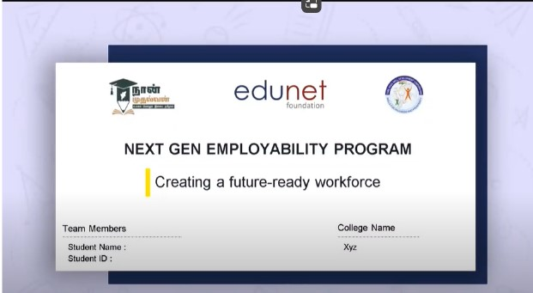
NEXT GEN EMPLOYABILITY PROGRAM
Creating a future-ready workforce
Team Members
College Name
………………………………………...............
………………………………………...............
Student Name : Divya V
Student ID : au613021205010
VIVEKANANDHA COLLEGE OF TECHNOLOGY FOR WOMEN

Slide 2
CAPSTONE PROJECT SHOWCASE
Project Title
Notes Sharing Web Application using Django Framework
Abstract | Problem Statement | Project Overview | Proposed Solution | Technology Used | Modelling & Results | Conclusion

Slide 3
Next Gen Employability Program
Abstract
Our project aims to create a comprehensive notes sharing web application utilizing Python and Django frameworks. The platform offers a plethora of features such as multi-platform synchronization, collaborative editing, and intelligent note organization. By leveraging machine learning algorithms, the application provides personalized recommendations and insights, enhancing user productivity and learning outcomes. With a focus on usability and scalability, the platform caters to the diverse needs of students, educators, and professionals in today's knowledge-driven world.

Slide 4
Next Gen Employability Program
Problem Statement
User Authentication Enhancement : Implement a more secure and user-friendly authentication system for the notes sharing web application, allowing users to sign up, log in, and reset their passwords securely.

Slide 5
Next Gen Employability Program
Project Overview
The Notes Sharing Web Application is an innovative project aimed at providing users with a platform to create, organize, and share their notes effortlessly. Built using Python with the Django framework, this application offers a user-friendly interface coupled with robust functionalities to enhance productivity and collaboration among users.
Key Features:
User Authentication: Users can register and log in securely to access the platform. Authentication mechanisms ensure data security and privacy.
Security Measures: Implement security measures such as HTTPS encryption, CSRF protection, and input validation to safeguard user data and prevent unauthorized access.
Collaborative Editing: Enable collaboration by allowing users to share notes with others. Multiple users can edit a note simultaneously, facilitating real-time collaboration.

Slide 6
Next Gen Employability Program
Proposed Solution
The proposed solution aims to develop a robust notes sharing web application using Python with the Django framework. This application will facilitate seamless sharing and collaboration on notes among users, providing a user-friendly interface and robust security measures.
Implement a secure user authentication system allowing users to sign up, log in, and manage their accounts securely.
Users can create, edit, and delete their notes. Rich text editing capabilities can be integrated to enhance the note-taking experience.
Enable users to share their notes with other users, allowing for real-time collaboration on notes. Implement features such as version control to track changes and revisions.
Implement a robust search functionality allowing users to easily find specific notes based on keywords, tags, or categories.
Provide users with customizable profiles where they can manage their preferences, view shared notes, and connect with other users.
Employ best practices for security, including encryption of sensitive data, protection against common web vulnerabilities such as CSRF and XSS attacks, and secure storage of user credentials.
Develop a responsive web design ensuring the application is accessible and functional across various devices and screen sizes.
Provide an admin dashboard with tools to manage users, monitor activity, and moderate content.

Slide 7
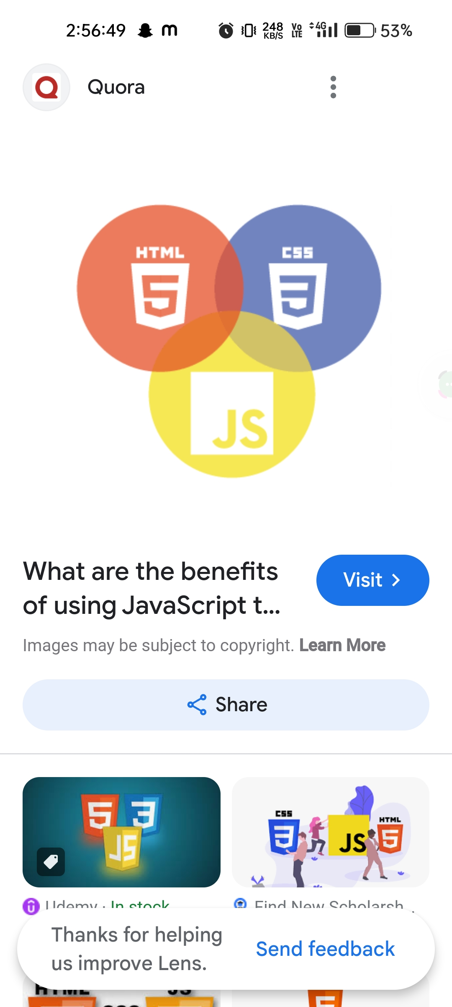

Next Gen Employability Program
Technologies Used
Frontend
Backend

Slide 8
Next Gen Employability Program
Modelling & Results
Python: Primary programming language for backend development.
Django Framework: High-level Python web framework for rapid development and clean, pragmatic design.
HTML/CSS/JavaScript: Frontend development technologies for creating dynamic and interactive user interfaces.
SQLite/PostgreSQL: Database management systems for storing and retrieving note data efficiently.
RESTful APIs: Facilitate communication between the frontend and backend components.
Git: Version control system for collaborative development and code management.
********** Results are given as screenshots in the upcoming slides **********

Slide 9
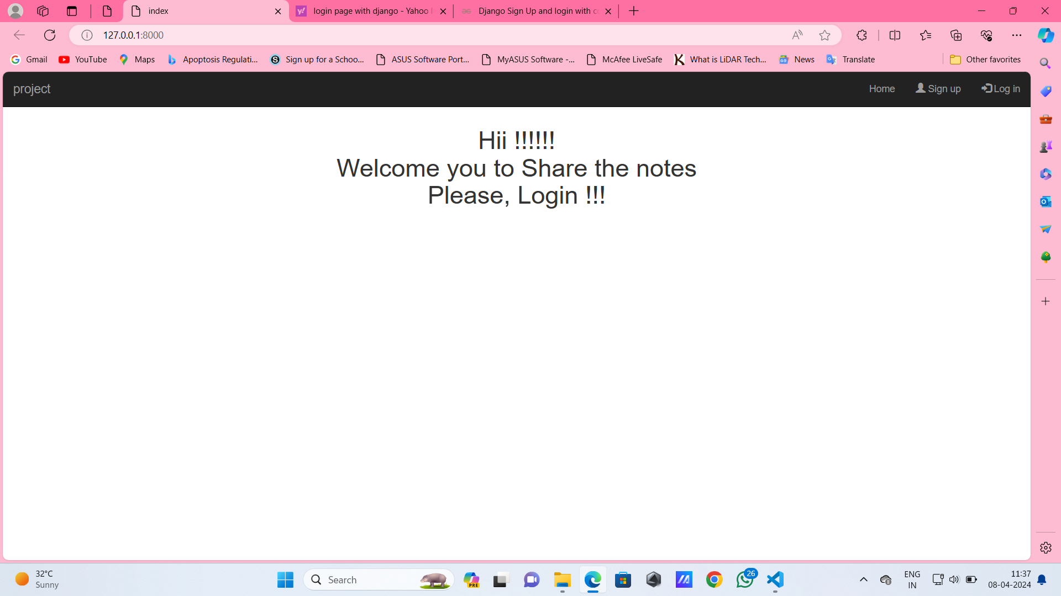
Next Gen Employability Program
Home Page

Slide 10
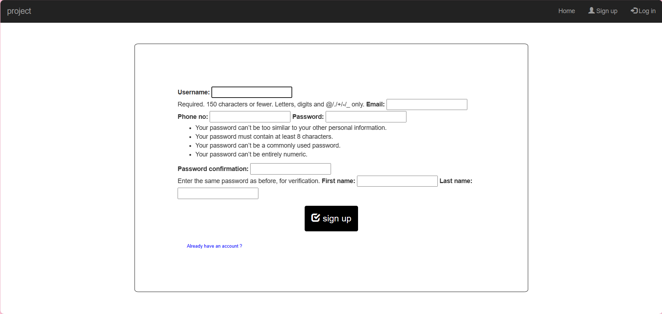
Next Gen Employability Program
SignUp Page

Slide 11
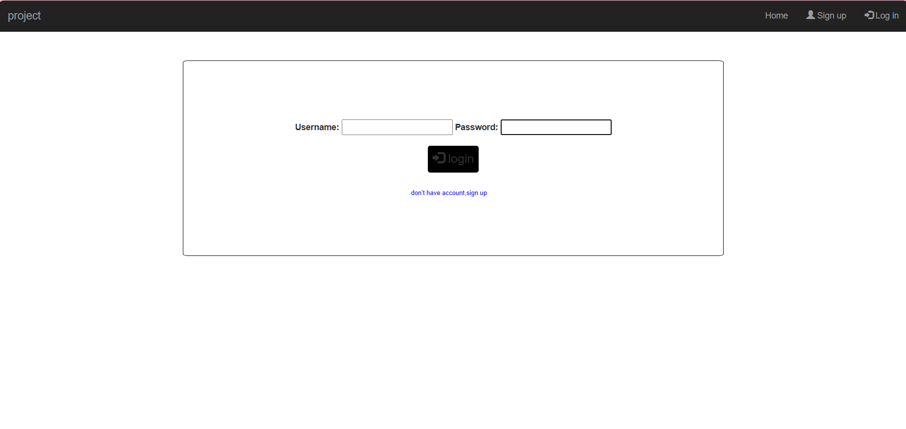
Next Gen Employability Program
Login Page

Slide 12
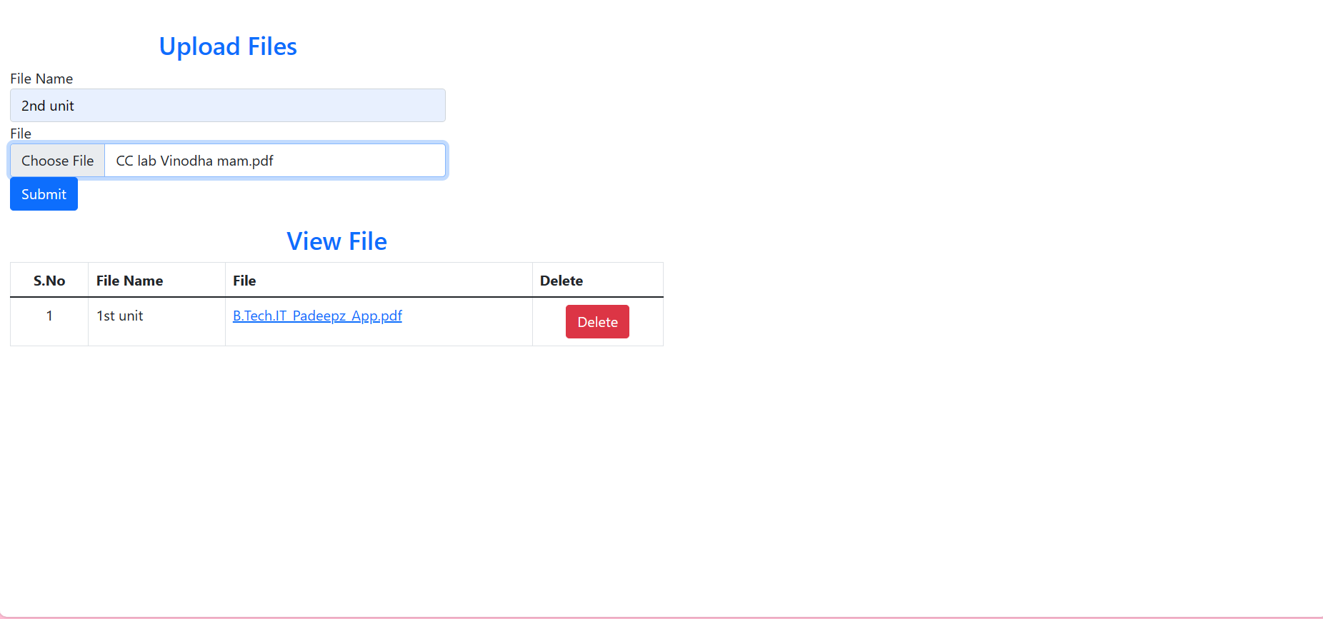
Next Gen Employability Program
Files Uploading Page

Slide 13
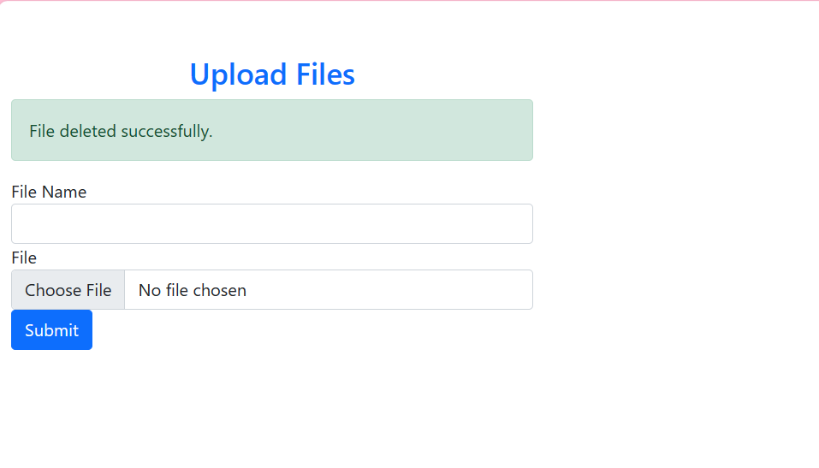
Next Gen Employability Program
Files Deleting Page

Slide 14
Next Gen Employability Program
Future Enhancements
Develop a robust and user-friendly notes sharing web application.
Enhance productivity and collaboration among users through advanced features.
Ensure scalability, security, and reliability of the application.
Provide comprehensive documentation and support for seamless deployment and maintenance.

Slide 15
Next Gen Employability Program
Conclusion
The Notes Sharing Web Application is poised to revolutionize the way users create, manage, and share notes online. With its intuitive interface, powerful features, and robust architecture, the application promises to streamline workflows, foster collaboration, and elevate productivity. Through continuous improvement and user feedback, we aim to create a platform that meets the evolving needs of our users and remains a valuable tool for personal and professional use.

Slide 16
Next Gen Employability Program
Thank You !

